Slide 1

UNIVERSITY OF RWANDA
COLLEGE OF SCIENCE AND TECHNOLOGY
ICT LEVEL III
NAMES :ISHIMWE ELISSA
Reg :220012479
NO:16
TOPIC: DENIAL OF SERVICES
21/OCTOBER 2022

Slide 2
DENIAL OF SERVICES
A denial-of-service (DoS) attack is a security threat that occurs when an attacker makes it impossible for legitimate users to access computer systems, network, services or other information technology (IT) resources. Attackers in these types of attacks typically flood web servers, systems or networks with traffic that overwhelms the victim's resources and makes it difficult or impossible for anyone else to access them.
A denial-of-service attack is different from most types of vulnerabilities , as the intent of the attack isn’t to compromise a system or website: the intent is to simply make it unavailable to other users. Generally, this is achieved by flooding the site with inbound traffic

Slide 3
TYPES OF DENIAL OF SERVICES ATTACK
1.Internet Control Message Protocol Attacks: The Internet Control Message Protocol (ICMP) is a network layer protocol used by network devices to diagnose network communication issues. ICMP is mainly used to determine whether or not data is reaching its intended destination in a timely manner. Commonly, the ICMP protocol is used on network devices, such as routers. ICMP is crucial for error reporting and testing, but it can also be used in distributed denial-of-service attacks.
The primary purpose of ICMP is for error reporting. When two devices connect over the Internet, the ICMP generates errors to share with the sending device in the event that any of the data did not get to its intended destination. For example, if a packet of data is too large for a router, the router will drop the packet and send an ICMP message back to the original source for the data. Unfortunately network attacks can exploit this process, creating means of disruption such as the ICMP flood attack and the ping of death attack.

Slide 4
Continuous
2.Transmission Control Protocol Attacks
TCP Reset Attack is a type of attack in which attackers send forged TCP RST (Reset) packets to the host. This is the most common attack on the Internet which is causing a lot of problems. These attacks are mainly performed to shut down the websites which are not working with them , when attacker shutdown network make unavailable
3. Application Layer Attacks Application layer attacks:
An attacker may target the application itself by using a layer 7 or application layer attack. In these attacks, similar to SYN flood infrastructure attacks, the attacker attempts to overload specific functions of an application to make the application unavailable or unresponsive to legitimate users

Slide 5
Continuous
4.Distributed denial of service (DDoS) attacks are a subclass of denial of service (DoS) attacks. A DDoS attack involves multiple connected online devices, collectively known as a botnet, which are used to overwhelm a target website with fake traffic.
Unlike other kinds of cyberattacks, DDoS assaults don’t attempt to breach your security perimeter. Rather, a DDoS attack aims to make your website and servers unavailable to legitimate users.
In computing, a denial-of-service attack is a cyber-attack in which the perpetrator seeks to make a machine or network resource unavailable to its intended users by temporarily or indefinitely disrupting services of a host connected to a network.

Slide 6
Denial-of-Service Attack Mitigation
Attack Detection
The first step of any mitigation strategy is understanding when you are the target of a DoS attack. Analyzing incoming traffic and determining whether or not it's legitimate is the first step in keeping your service available and responsive
Allowing and Denying Specific IPs
The simplest defense against a DoS attack is either allowing only legitimate IP addresses or blocking ones from known attackers.
You can use firewalls or Access Control Lists (ACLs) to control what traffic reaches your applications.

Slide 7
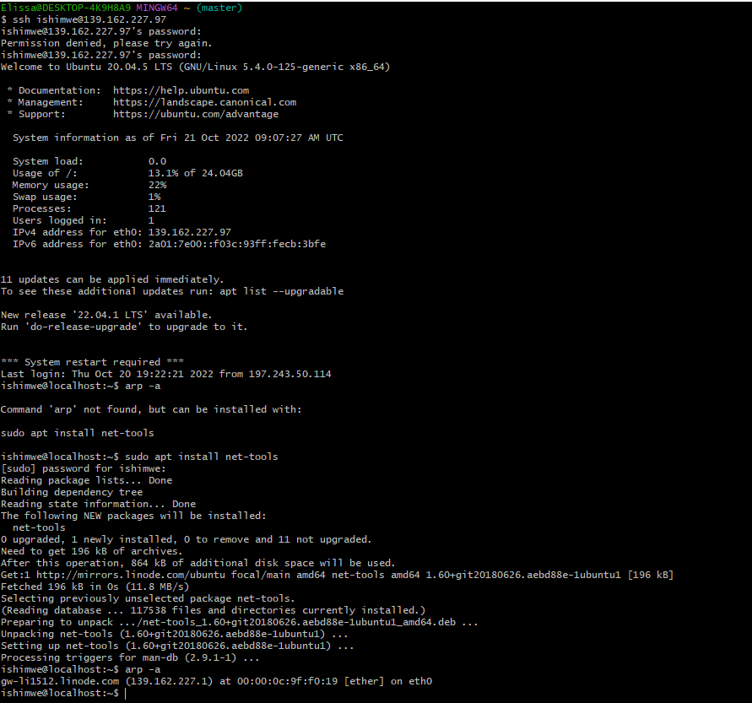
TO SEE ALL IP ON YOUR SERVER

Slide 8
THANK FOR YOUR KIND ATTENTION!!!!!!

